Slide 1

Computational Complexity
Presented by:
Elizer Ponio Jr.
Department of Computer Science
College of Computing and Information Technologies

Slide 2
What is Computational Complexity?
Computational complexity is a field from computer science which analyzes algorithms based on the amount resources required for running it.
The amount of required resources varies based on the input size, so the complexity is generally expressed as a function of n, where n is the size of the input.

Slide 3
Time Complexity
Time complexity is the computational complexity that describes the amount of time it takes to run an algorithm.
Time complexity is commonly estimated by counting the number of operations performed by the algorithm.

Slide 4
Best Case, Average Case and Worst Case
Suppose we have an unsorted list [1, 5, 3, 9, 2, 4, 6, 7, 8] and we need to find a number using linear search
Best case is the complexity of solving the problem for the best input. In this example, the best case would be to search for the value 1. Since this is the first value of the list, it would be found in the first iteration.

Slide 5

Best Case, Average Case and Worst Case
Suppose we have an unsorted list [1, 5, 3, 9, 2, 4, 6, 7, 8] and we need to find a number using linear search
Average Case is the average complexity of solving the problem. In this example, we could say that the average-case would be when we’re searching for some value in the “middle” of the list, for example, the value 2.

Slide 6
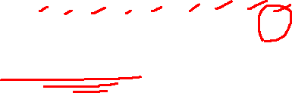
Best Case, Average Case and Worst Case
Suppose we have an unsorted list [1, 5, 3, 9, 2, 4, 6, 7, 8] and we need to find a number using linear search
Worst case is the complexity of solving the problem for the worst input of size n. In this example, the worst-case would be to search for the value 8, which is the last element from the list.

Slide 7
What is Big-O notation?
Big-O notation is used to classify algorithms according to how their running time or space requirements grow as the input size (n) grows.
When using the Big-O notation, we describe the algorithm’s efficiency based on the increasing size of the input data (n).

Slide 8
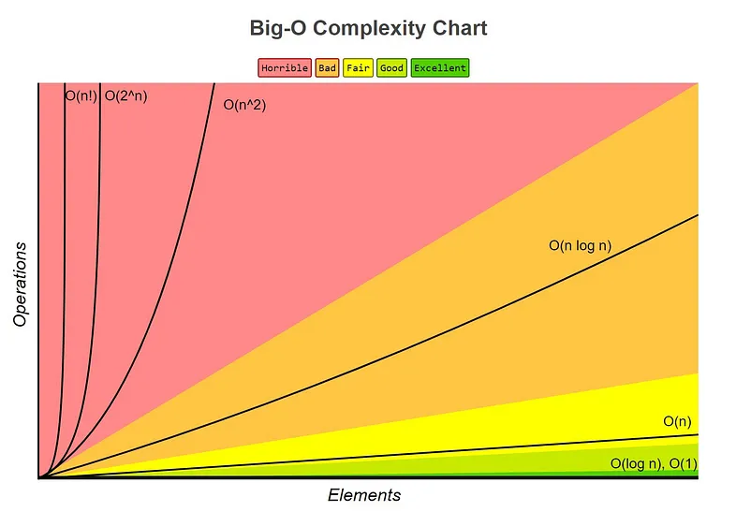
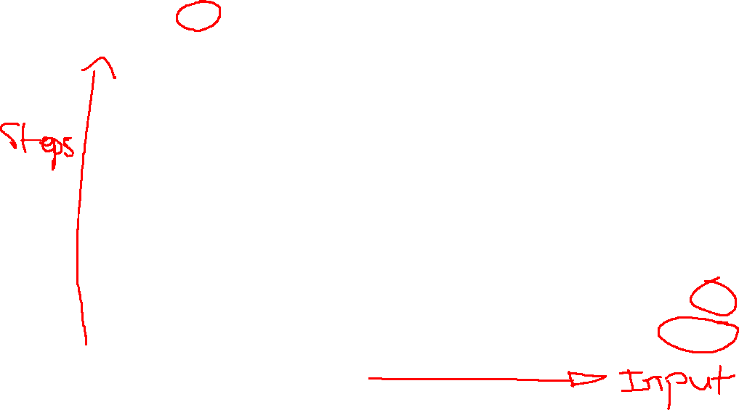
Source: https://www.bigocheatsheet.com/

Slide 9
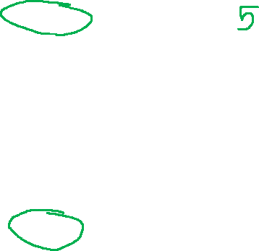
Name | Time Complexity
Constant Time | 0 (1)
Logarithmic Time | 0 (log n)
Linear Time | 0 (n)
Quasilinear Time | 0 (n log n)
Quadratic Time | 0 (n²)
Exponential Time | 0 (2^{n})
Factorial Time | 0 (n!)
For example, if the input is a string, the n will be the length of the string. If it is a list, the n will be the length of the list and so on.
Source: https://www.bigocheatsheet.com/

Slide 10
Constant Time - 0(1)
An algorithm is said to have a constant time when it is not dependent on the input data (n). No matter the size of the input data, the running time will always be the same.
Source: https://www.bigocheatsheet.com/

Slide 11
Logarithmic Time - 0(log n)
An algorithm is said to have a logarithmic time complexity when it reduces the size of the input data in each step (it don’t need to look at all values of the input data)
Source: https://www.bigocheatsheet.com/

Slide 12
Linear Time - 0(n)
An algorithm is said to have a linear time complexity when the running time increases at most linearly with the size of the input data. This is the best possible time complexity when the algorithm must examine all values in the input data.
Source: https://www.bigocheatsheet.com/

Slide 13
Quasilinear Time - 0(n log n)
An algorithm is said to have a quasilinear time complexity when each operation in the input data have a logarithm time complexity.
Source: https://www.bigocheatsheet.com/

Slide 14
Quadratic Time - 0(n²)
An algorithm is said to have a quadratic time complexity when it needs to perform a linear time operation for each value in the input data.
Source: https://www.bigocheatsheet.com/

Slide 15
Exponential Time - 0(2^{n})
An algorithm is said to have an exponential time complexity when the growth doubles with each addition to the input data set. This kind of time complexity is usually seen in brute-force algorithms.
Source: https://www.bigocheatsheet.com/

Slide 16
Factorial Time - 0(n!)
An algorithm is said to have a factorial time complexity when it grows in a factorial way based on the size of the input data.
Source: https://www.bigocheatsheet.com/

Slide 17
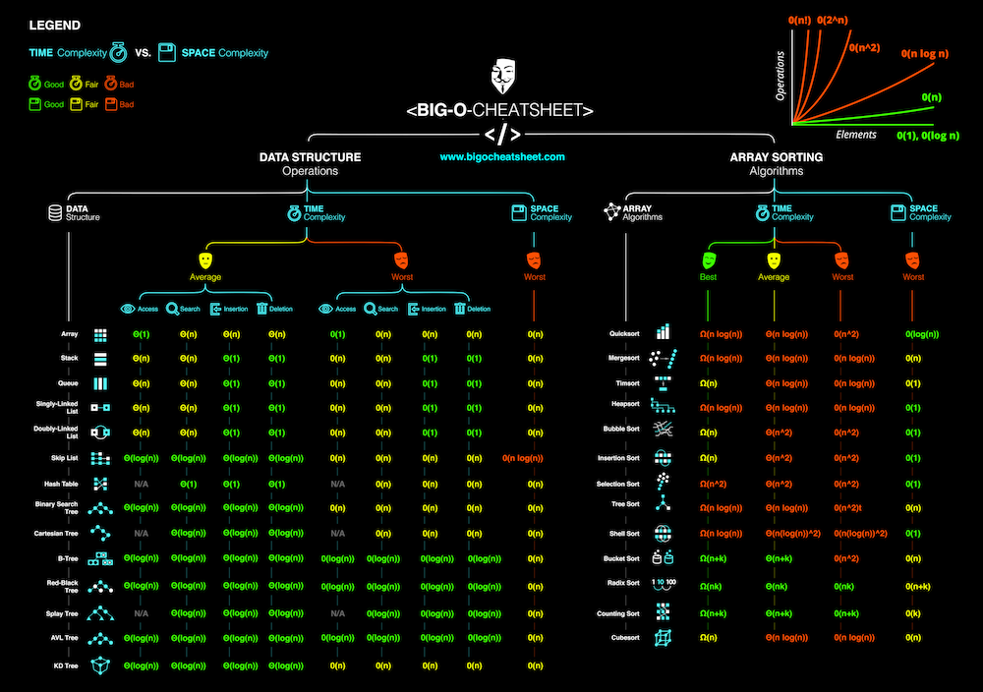
Source: https://www.bigocheatsheet.com/

